Slide 1
Predicting Housing Price using Regression methods
On Ames Iowa Housing Data

Slide 2
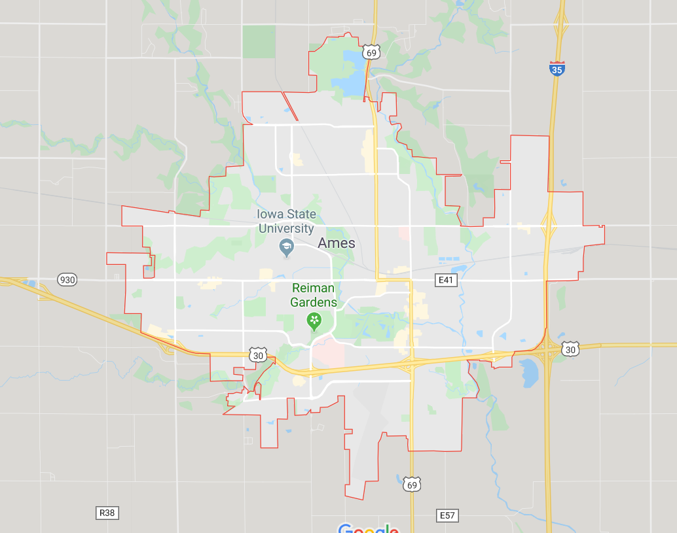
Ames IOWA
Ames is a city in Iowa United States, approximately 30 miles (48 km) north of Des Moines in central Iowa.
Home of Iowa State University (ISU), with leading Agriculture, Design, Engineering, and Veterinary Medicine colleges.
hosts United States Department of Agriculture (USDA) sites: the largest federal animal disease center in the United States
USDA's Agricultural Research Service's National Animal Disease Center (NADC)
one of two national USDA sites for the Animal and Plant Health Inspection Service (APHIS),
Ames is the headquarters for the Iowa Department of Transportation.
In 2017, Ames had a population of 66,498.Iowa State University is home to 36,321 students (Fall 2017),which make up approximately one half of the city's population.
In 2010, Ames was ranked ninth on CNNMoney's "Best Places to Live" list.
Source: Wikipedia

Slide 3

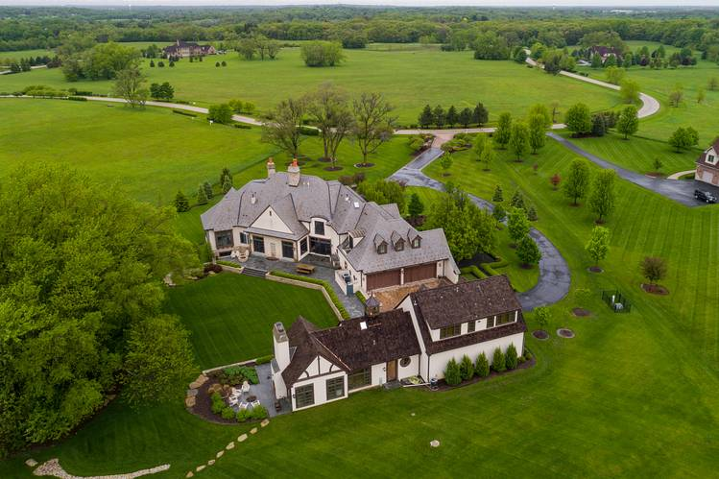

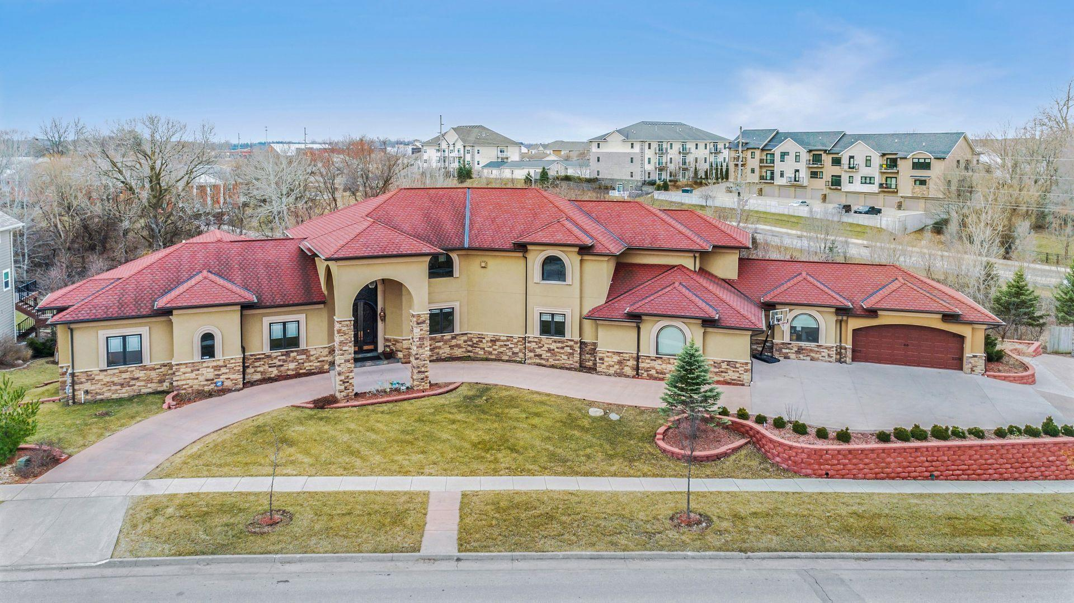
Dream home

Slide 4
What do Home Buyers look for?
How big is the house?
How old is it?
What's the house condition?
How many bedrooms?
How many bathrooms?
How is the Kitchen> -> dummy from 'Kitchen Qual'
Is the basement finished?
How big is the garage?
Does it near amenities/park/busy roads?
Is the neighbourhood safe?

Slide 5
Possible Variables for consideration
About the Unit
About the Surrounding
(outside the unit)
Lot Size
Total Living Space (above ground + base total/finished?)
Condition of the house (Rating?)
No of bedrooms
No of bathrooms
Kitchen condition/quality
Garage size (how many cars)
Basement: finished?
Age of the house
Condition of the house (structural materials, remodelling,)
Location
Easy access to amenities
Easy access to main road
Access to transportation
Traffic flow
Which neighbourhood
Location within the neighbourhood

Slide 6
Surrounding
Location
Easy access to amenities
parks,
good school,
and?
Access to transportation
railway, freeway – how near/how far
Easy access to main road
Traffic flow
Which neighbourhood
Crime rate (over the past few years, and trends)
Average Income per household by neighbourhood
Aesthetics
Homeowner Association (HOA) Yes/No
Personal preference
Amenities within HOA/neighbourhood
Exercise facilities, swimming pool, children playground,
water features/pond/lake
Nature preserve, park
Gofl course
Location within the neighbourhood
Near main entry, or away from traffic, or further into development
Cul-de-sacs or on the main boulevard?
Cul-de-sacs is preferred by some family (safer for children to play)

Slide 7
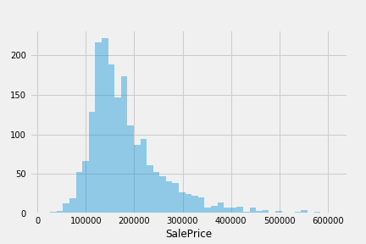
Sale Price Distribution

Slide 8
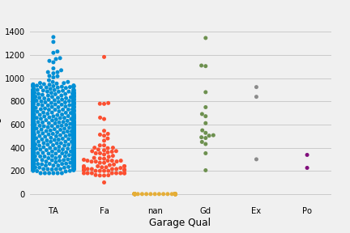
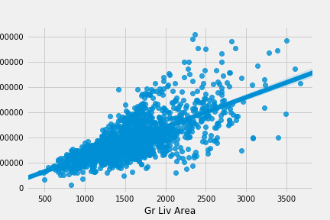

Slide 9
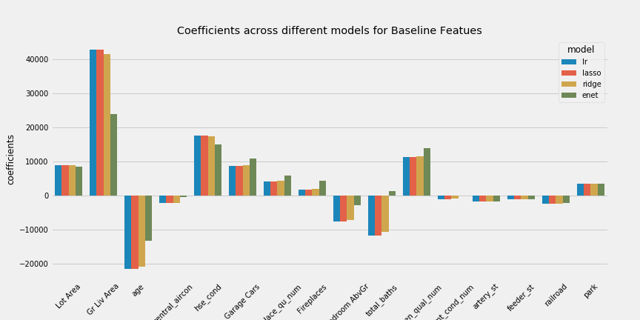
Linear Regression Modeling Techniques
Linear Regression
Lasso Regression
Ridge Regression
ElasticNet Regression

